Slide 1

Fetal health classification
What do you know about your child and maternal health?
Then, how do you prevent those health problems?

Slide 2
Child and Maternal Mortality
During pregnancy, a woman’s body goes through many changes. These changes are entirely normal, but may become very important in case there are complications or problems.
About 700 women die each year in the United States as a result of pregnancy or delivery complications.
295,000 deaths during and following pregnancy and childbirth in 2017.
The vast majority of these deaths (94%) occurred in low-resource settings, and most could have been prevented.

Slide 3
Cardiotocograms (CTGs)
A technique of measuring fetal well-being
It send ultrasound pulses and reading its response, thus shedding light on fetal heart rate (FHR), fetal movements, uterine contractions and more.
Simple and cost accessible
Allow healthcare professionals to take early action in order to prevent child and maternal mortality

Slide 4
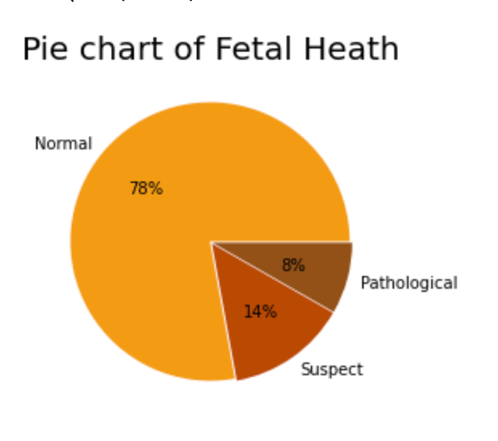
Exploratory Data Analysis
-The scope of this project is to build several machine learning algorithms which can predict and classify the health of the fetus with the best accuracy possible
-The dataset contains 2126 records of features extracted from Cardiotocogram exams, which were then classified by expert obstetrician into 3 classes:
Normal
Suspect
Pathological
Data is seem be imbalance

Slide 5
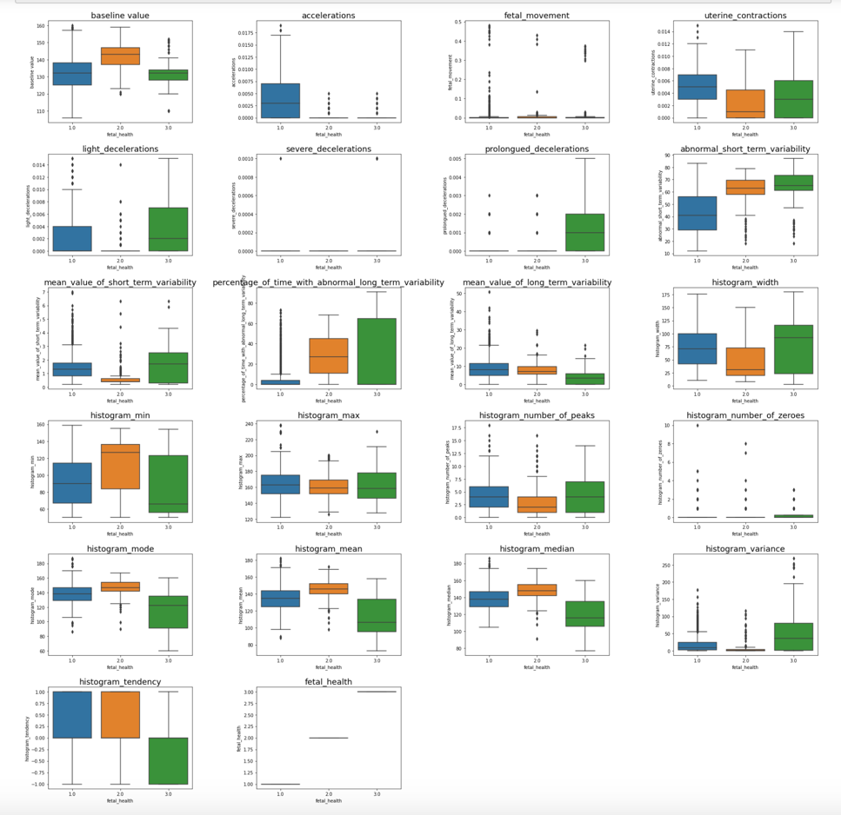
Exploratory Data Analysis
Most of the box plots show that Normal and Suspect are highly overlapping.
We can see our label as a continuous variable because as the number increases in magnitude is more likely that the fetal would have a health problem, therefore we could correlate this with the features and interpret a positive Pearson correlation as a feature with direct proportion to a health problem.

Slide 6
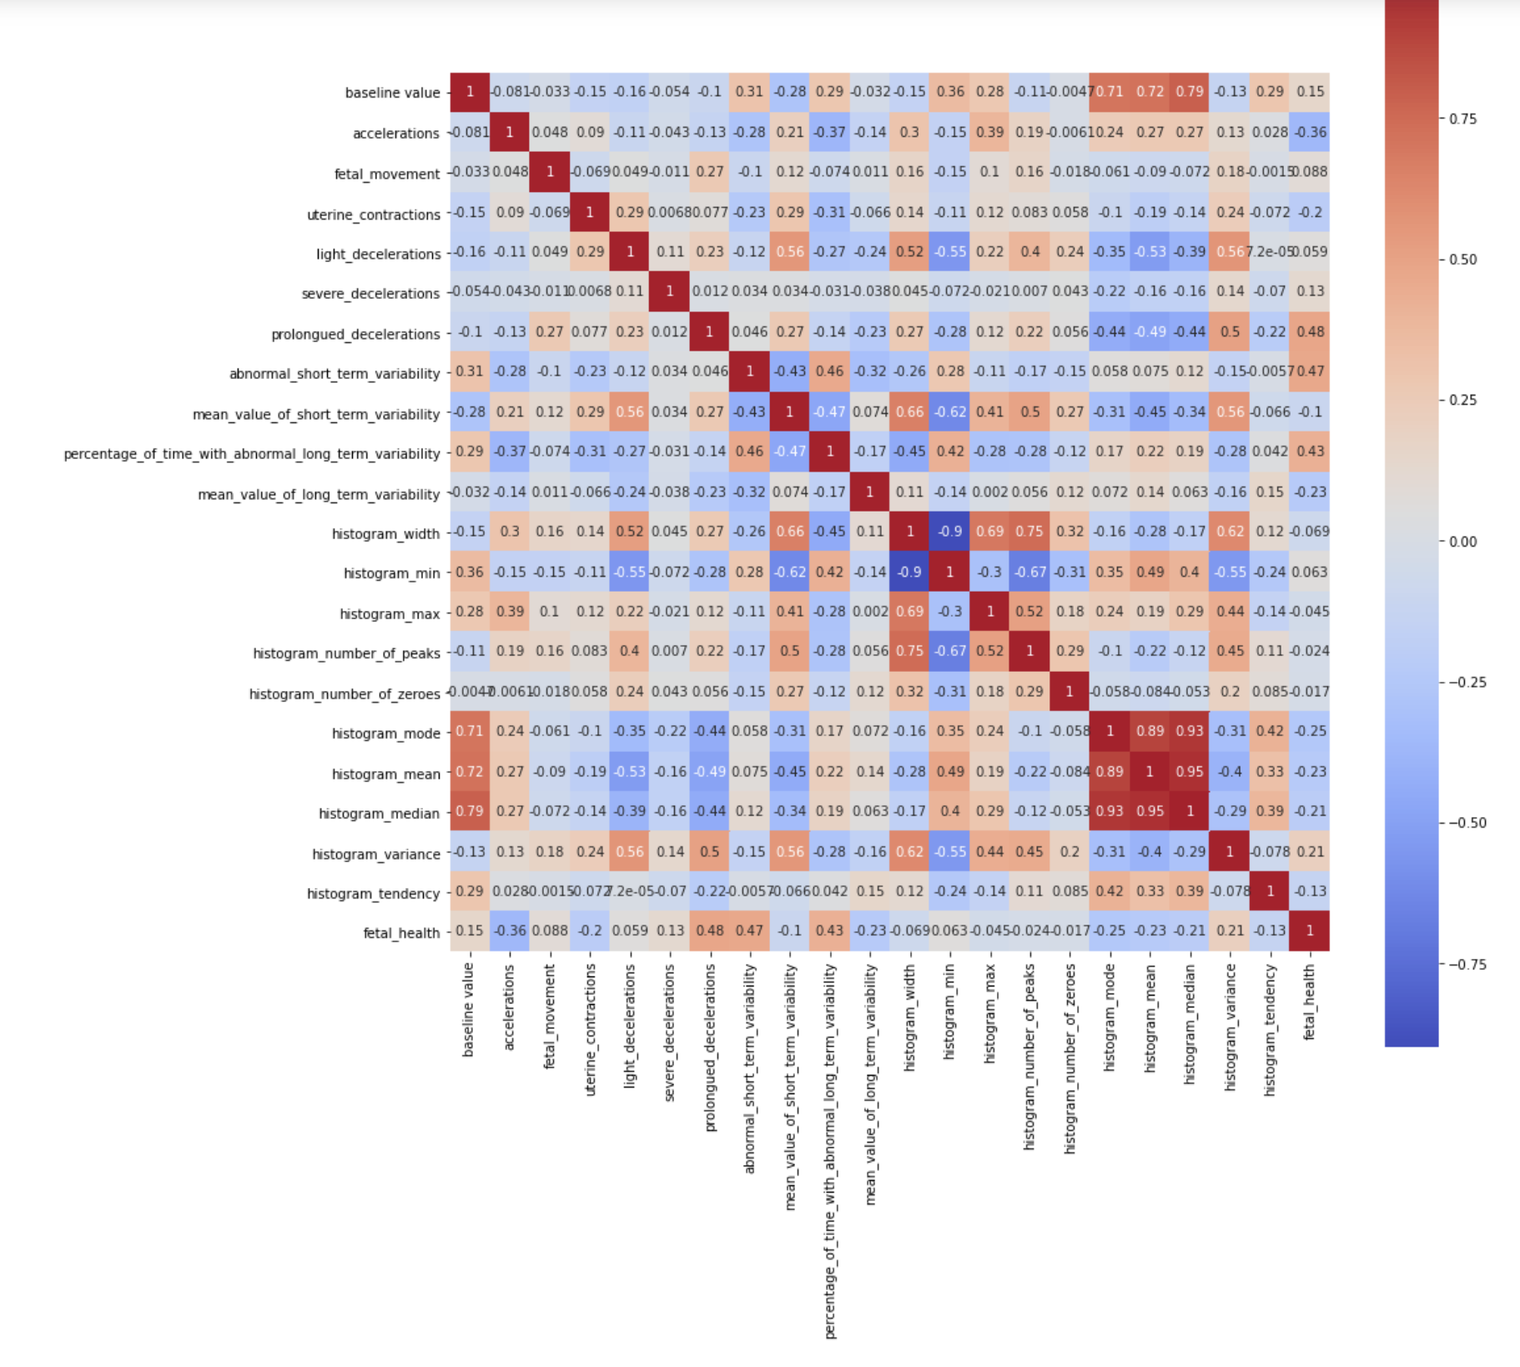
How features correlate with fetal health?
Based on the correlation matrix, it is clear that:
"prolongued_decelerations",
"abnormal_short_term_variability",
"percentage_of_time_with_abnormal_long_term_variability"
are the features with higher correlation with fetal_health.

Slide 7
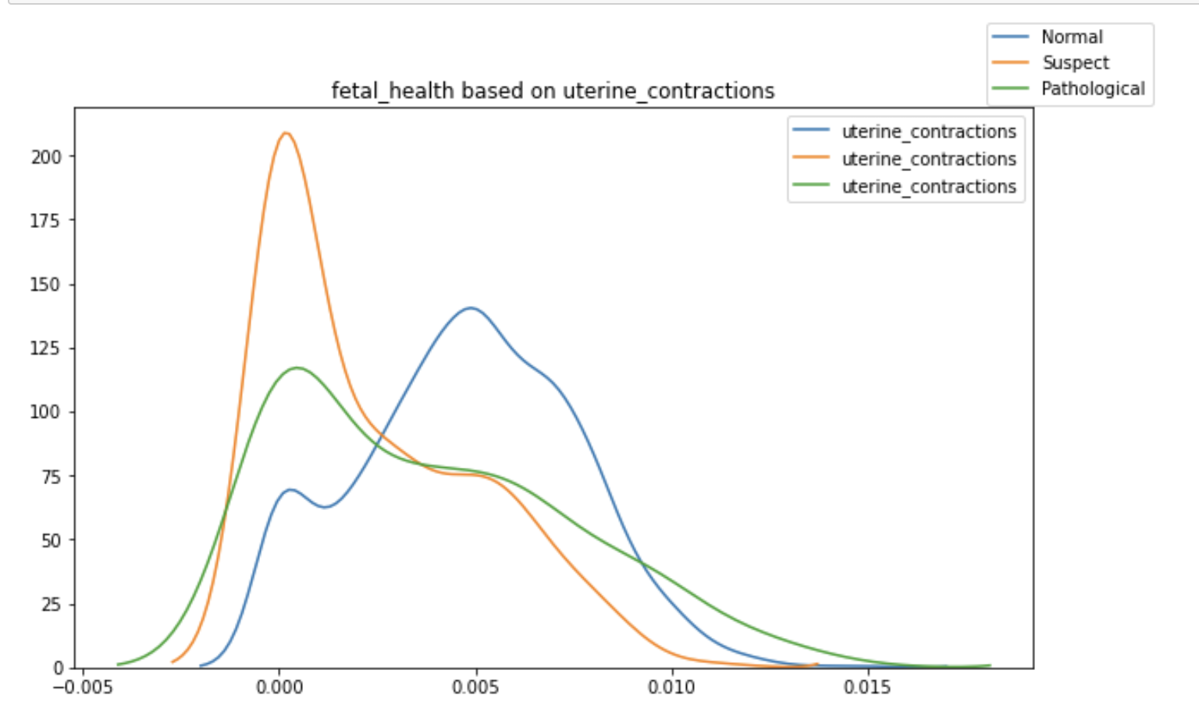
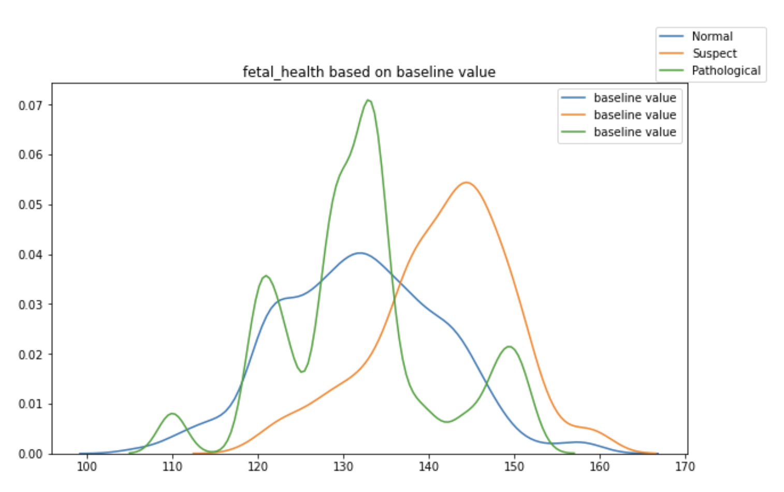
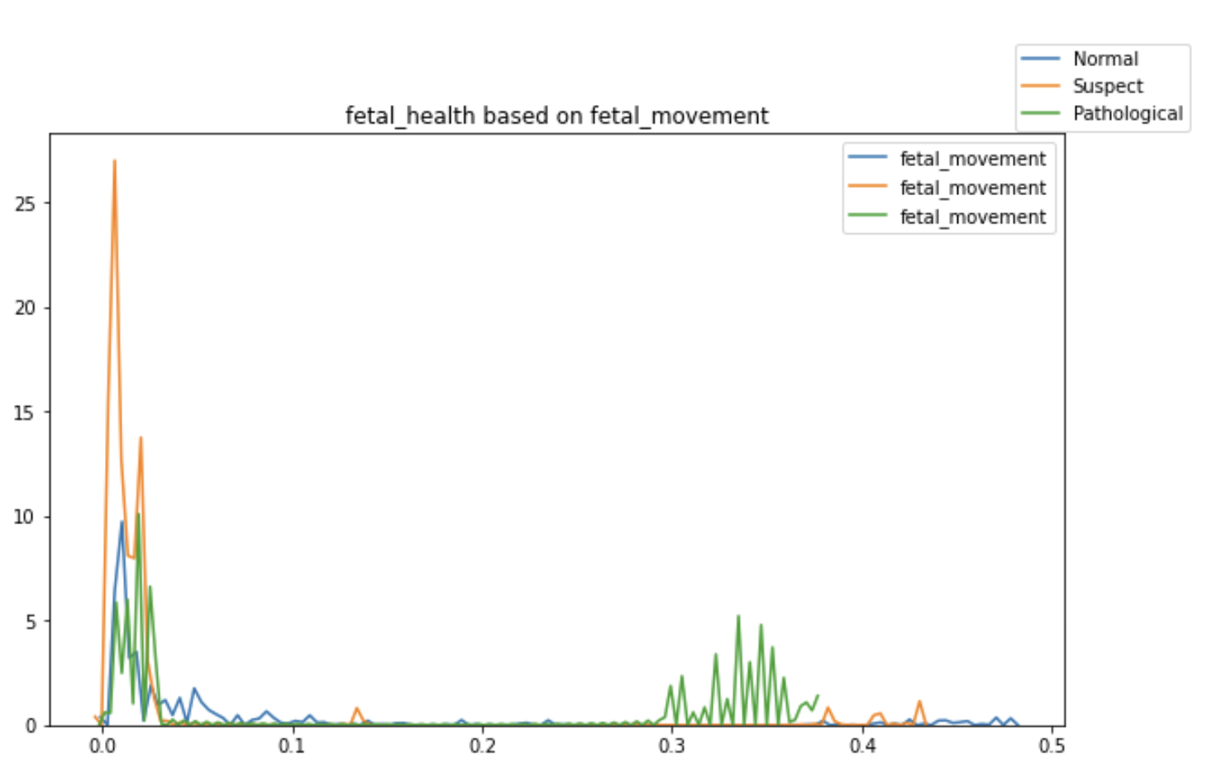
Correlations
As we see above:
Normal when uterine_contractions is > 0.0025 and Suspect when uterine_contractions is < 0.0025
Pathological when baseline value is between 125-135 and Suspect when baseline value is 135+
Suspect when fetal_movement is < 0.03 and Pathological when fetal_movement is between 0.3-0.38

Slide 8
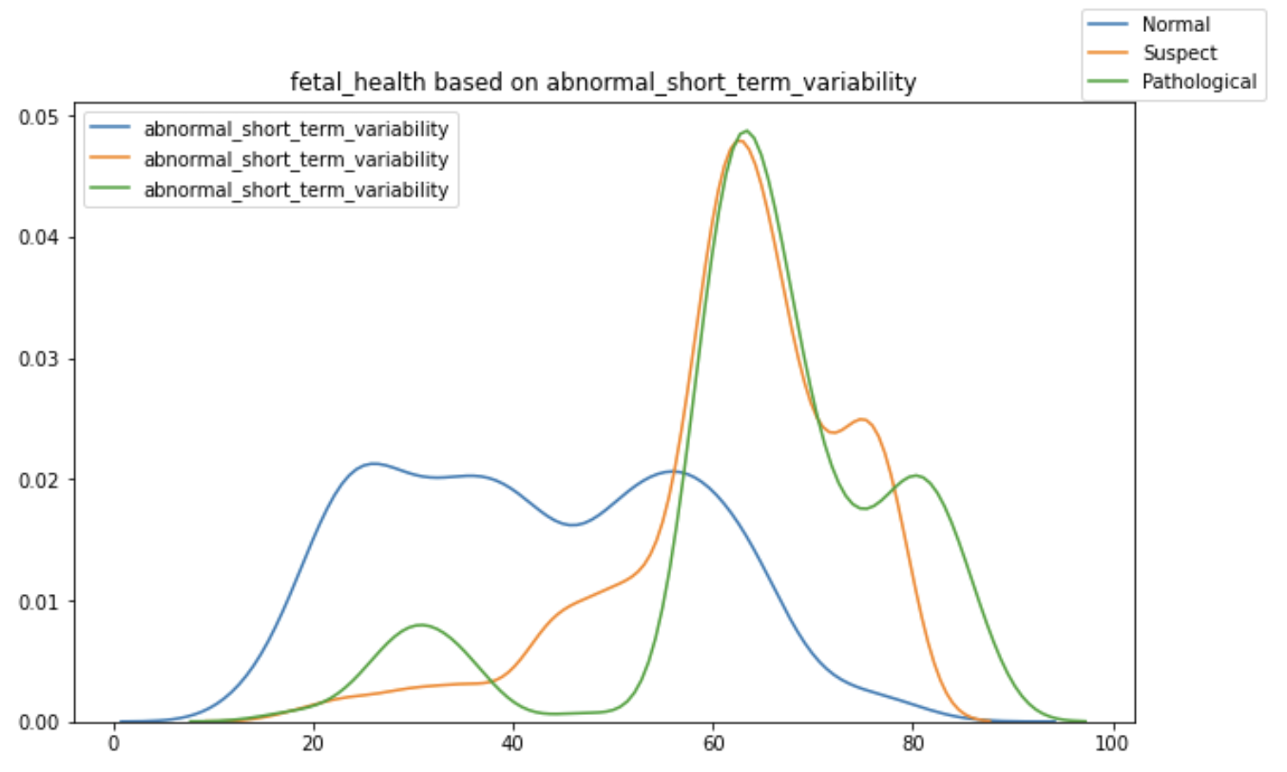
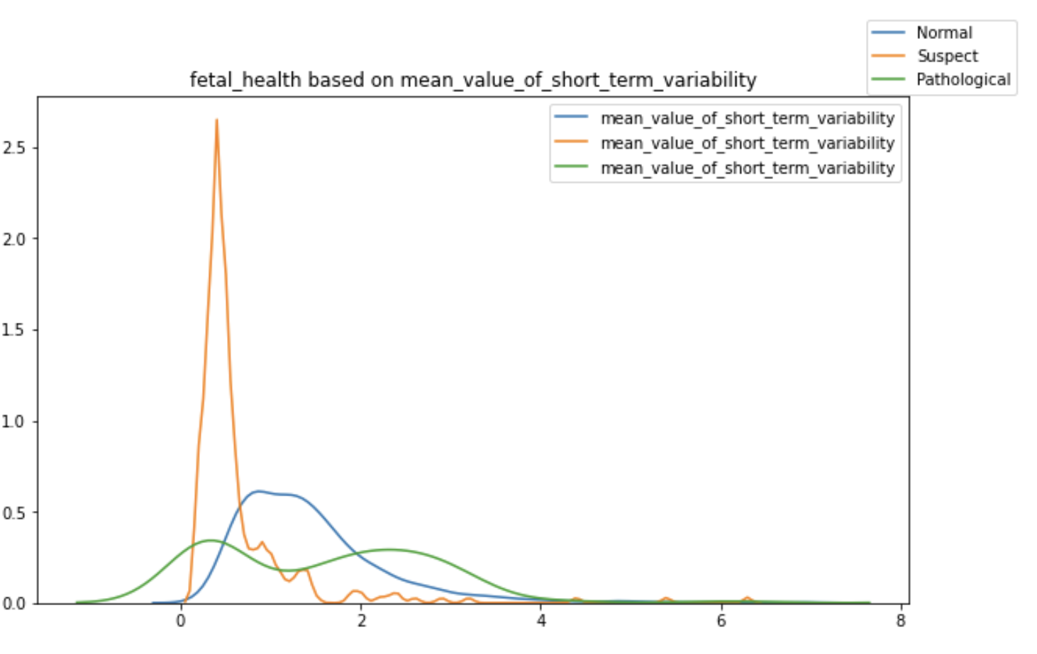
Correlations
As we see above:
Normal when abnormal_short_term_variability is <50
Suspect when mean_value_of_short_term_variability <0.8, Normal is 0.8-2, Pathological is >2

Slide 9
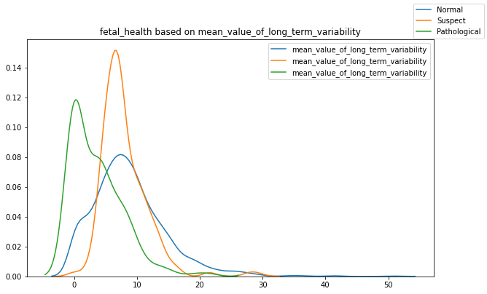
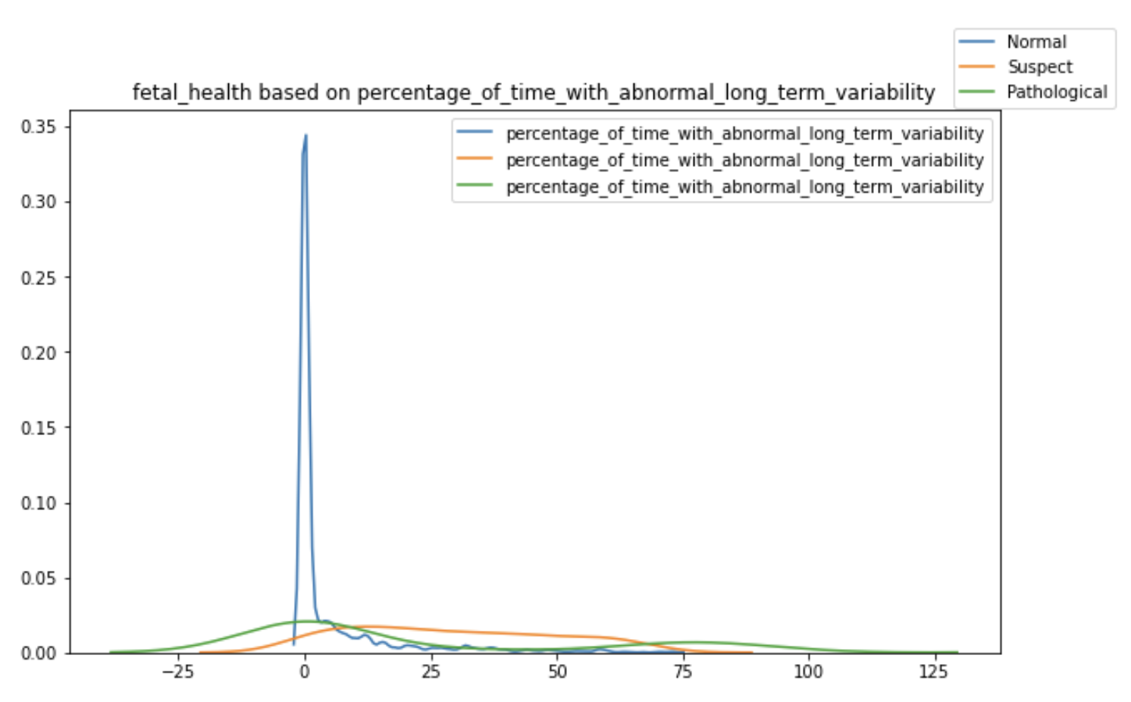
Correlations
As we see above:
Normal when percentage_of_time_with_abnormal_long_term_variability between (-8)-8, Suspect is 8-68 and Pathological is <-8 & >68
Pathological when mean_value_of_long_term_variability <3 , Suspect is 3-10 and Normal is 10+

Slide 10
Modeling
Scale data in to the same range
Create a 70/30 Train and Test split on data
Linear Regression
Fit Random Forest Classifier
Gradient Boosting

Slide 11
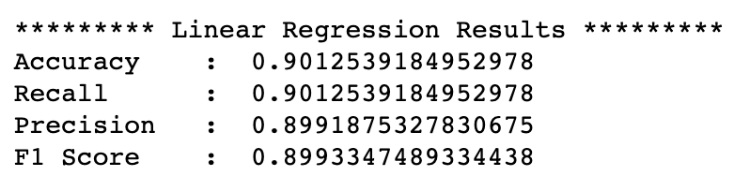
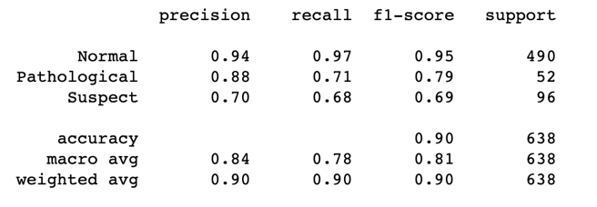
Modeling
Linear Regression
max_iter=1000
95% accuracy and 89% on precision and F1 score. This model performance is quite low

Slide 12
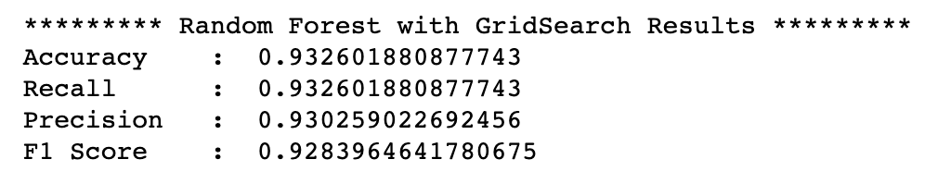
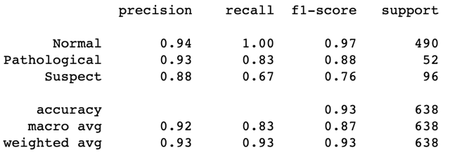
Modeling
Random Forest Classifier
Grid search is be used to find the best hyperparameters for the model
The best model parameters are selected with accuracy score of 93.
Better performance than the previous model Linear Regression

Slide 13
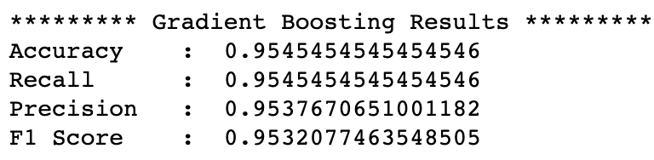
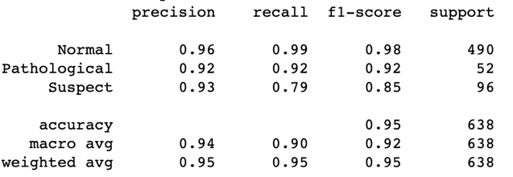
Modeling
Gradient Boosting
The model is tested with multiple learning rates from 0.05 to 1 to tune the learning rate from over fitting
We got the highest accuracy score in training and validation with learning rate at 0.25
The model turns out better with higher score accuracy at 95%

Slide 14
Conclusion
We can see above that all models are above 90% of accuracy, but as we compare all the models together, Gradient Boosting model is the best model with most highest accuracy at 95%.
This model could benefit the medical personnel in the task of automating the diagnosis of fetus and maternal health given the information gathered by the exam saving time, budget, also help in the search of the most impactful metrics or those most correlated to any pathology and finally in the aim to early detect diseases in both patients.

